Slide 1
Comparative Study for Reddit Sentiment Analysis
COEN 241
Team Name - YMSA
Yash Patki
Manas Sadhwani
Siddarth Palagrahara Chandrashekar
Anagha Bapat

Slide 2
Introduction to Sentiment Analysis
Sentiment analysis (also known as opinion mining or emotion AI) refers to the use of natural language processing, text analysis and computational linguistics to identify and study affective states and subjective information.
The analyzed data quantifies the general public's sentiments or reactions toward certain products, people or ideas and reveal the contextual polarity of the information.

Slide 3
Need for Sentiment Analysis
Useful in social media monitoring
Allows us to gain an overview of the wider public opinion behind certain topics
Useful in Market Research & Marketing Strategy
Helps improve the overall product
Helps in generating lead

Slide 4
Purpose and Goals
A comparative study of the sentiment analysis services provided by Google Cloud and Amazon AWS. Comparison of performance, accuracy, cost and other features provided on these cloud services.
Developing an application for scanning replies on reddit and performing sentiment analysis using AWS and Google Cloud Platform.

Slide 5






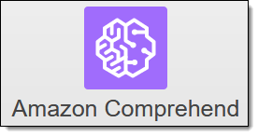
Reddit Sentiment Analysis using AWS:
The system is set to evaluate replies on a reddit post passed as an URl to the script, to provide insights and to get a general idea of the nature of the replies and visualize them using kibana
We will focus on data collection, data storing, data evaluation and data visualising using AWS services

Slide 6
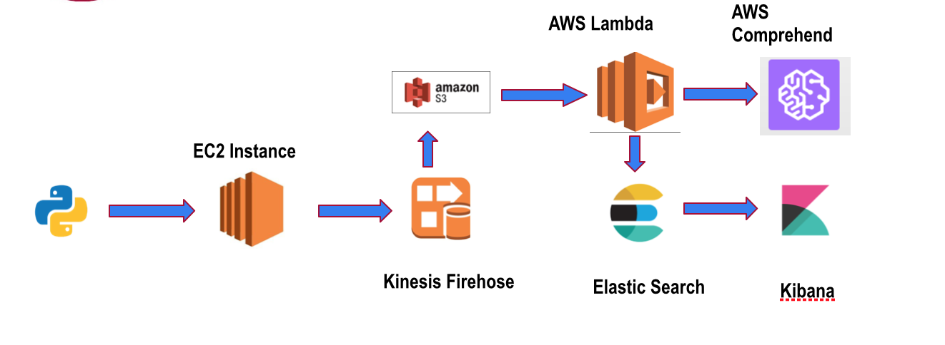
System Architecture

Slide 7
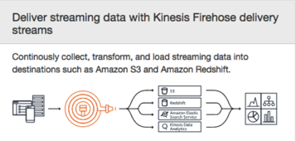
Kinesis Firehose :
Amazon Kinesis Data Firehose is a fully managed service for delivering real-time streaming data to destinations such as Amazon Simple Storage Service (Amazon S3), Amazon Elasticsearch Service (Amazon ES), and Splunk.
You can set your data producers to send data to Kinesis Data Firehose, and it automatically delivers the data to the destination that you specified.

Slide 8
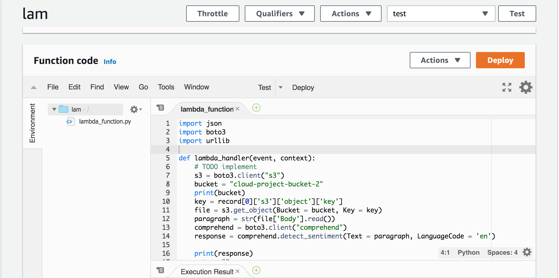
AWS Lambda :
AWS Lambda is a serverless compute service that runs your code in response to events and automatically manages the underlying compute resources.

Slide 9
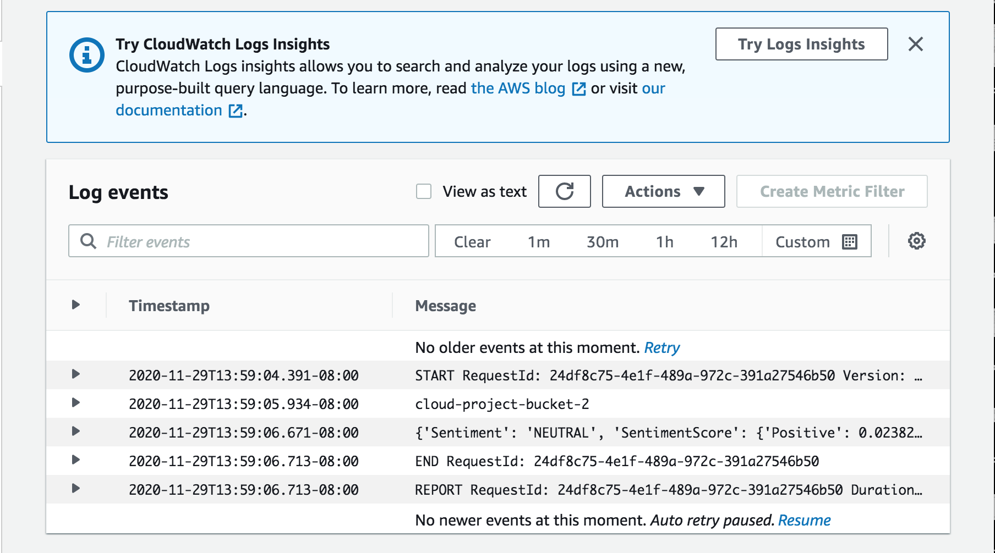
CloudWatch logs:
CloudWatch Logs enables us to see all of the logs, regardless of their source, as a single and consistent flow of events ordered by time, and you can query them and sort them based on other dimensions, group them by specific fields, create custom computations with a powerful query language, and visualize log data in dashboards.

Slide 10
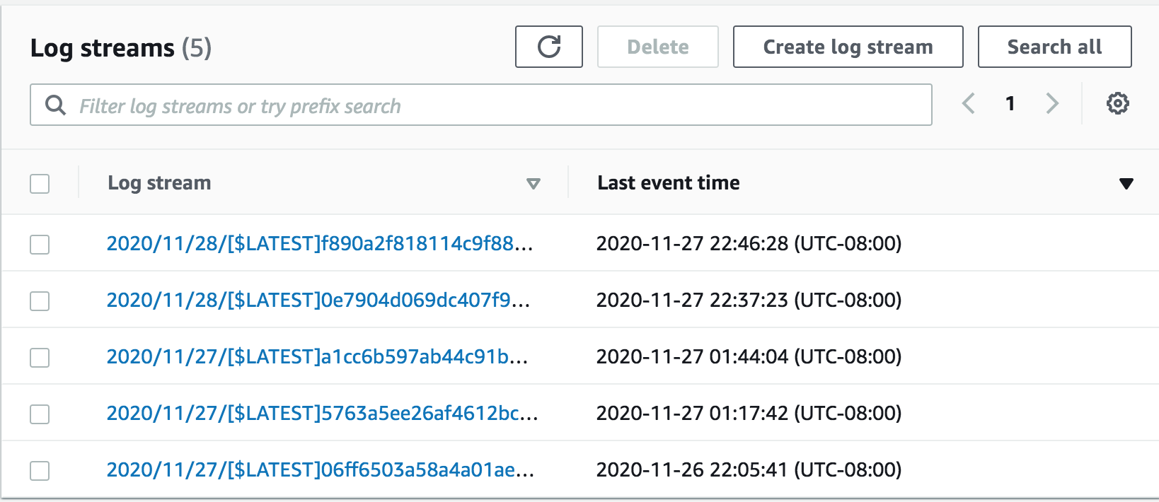
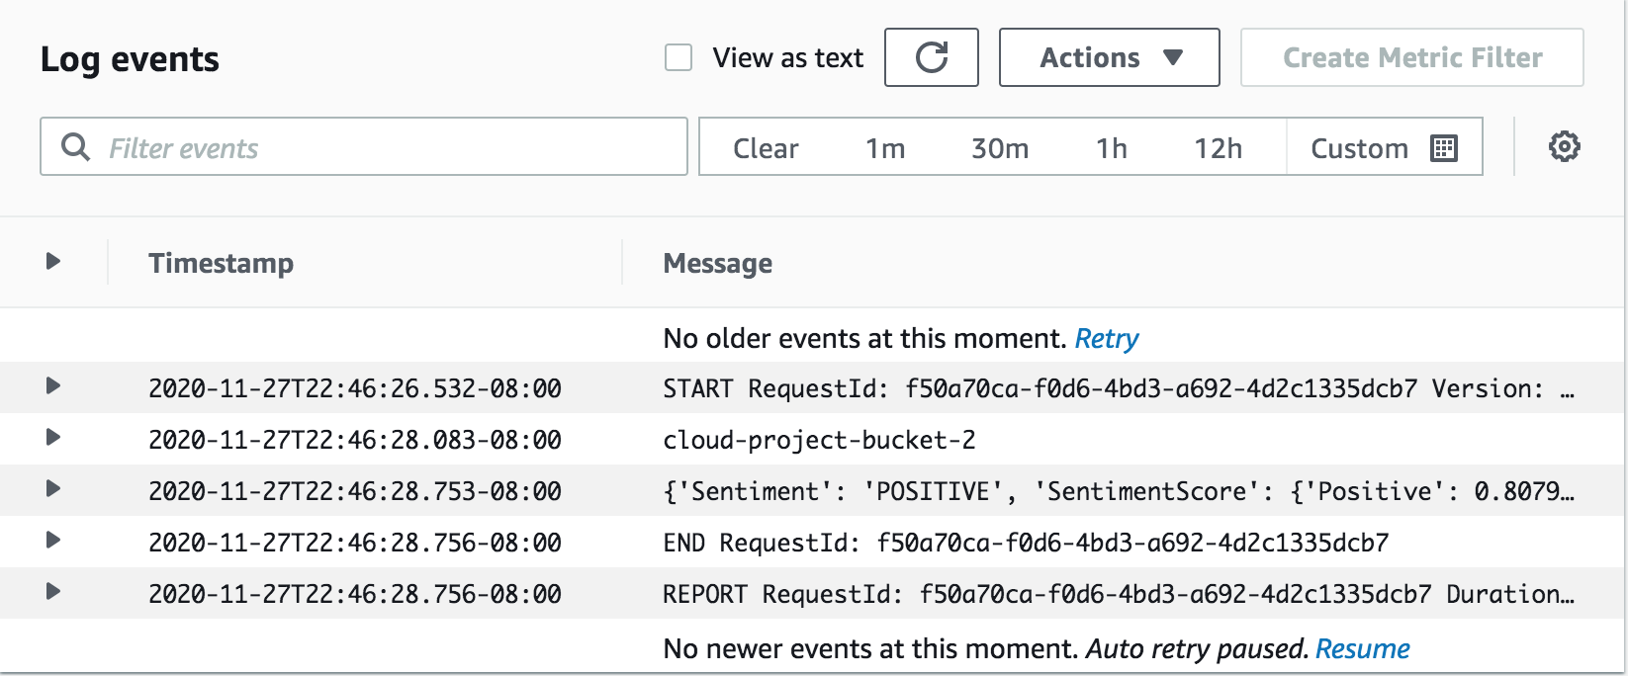
AWS Lambda Logs

Slide 11
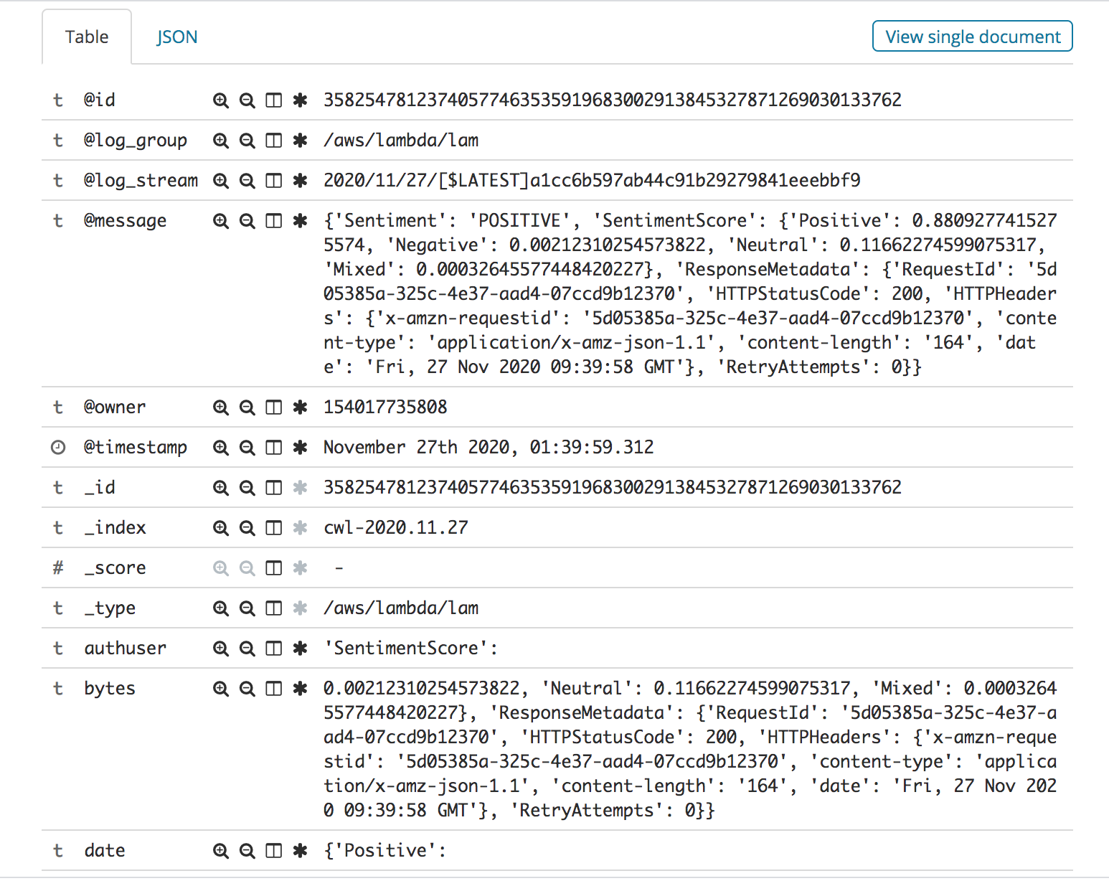
Elastic Search :
Elasticsearch is an open-source, broadly-distributable, readily-scalable, enterprise-grade search engine. Elasticsearch can power extremely fast searches that support your data discovery applications.

Slide 12
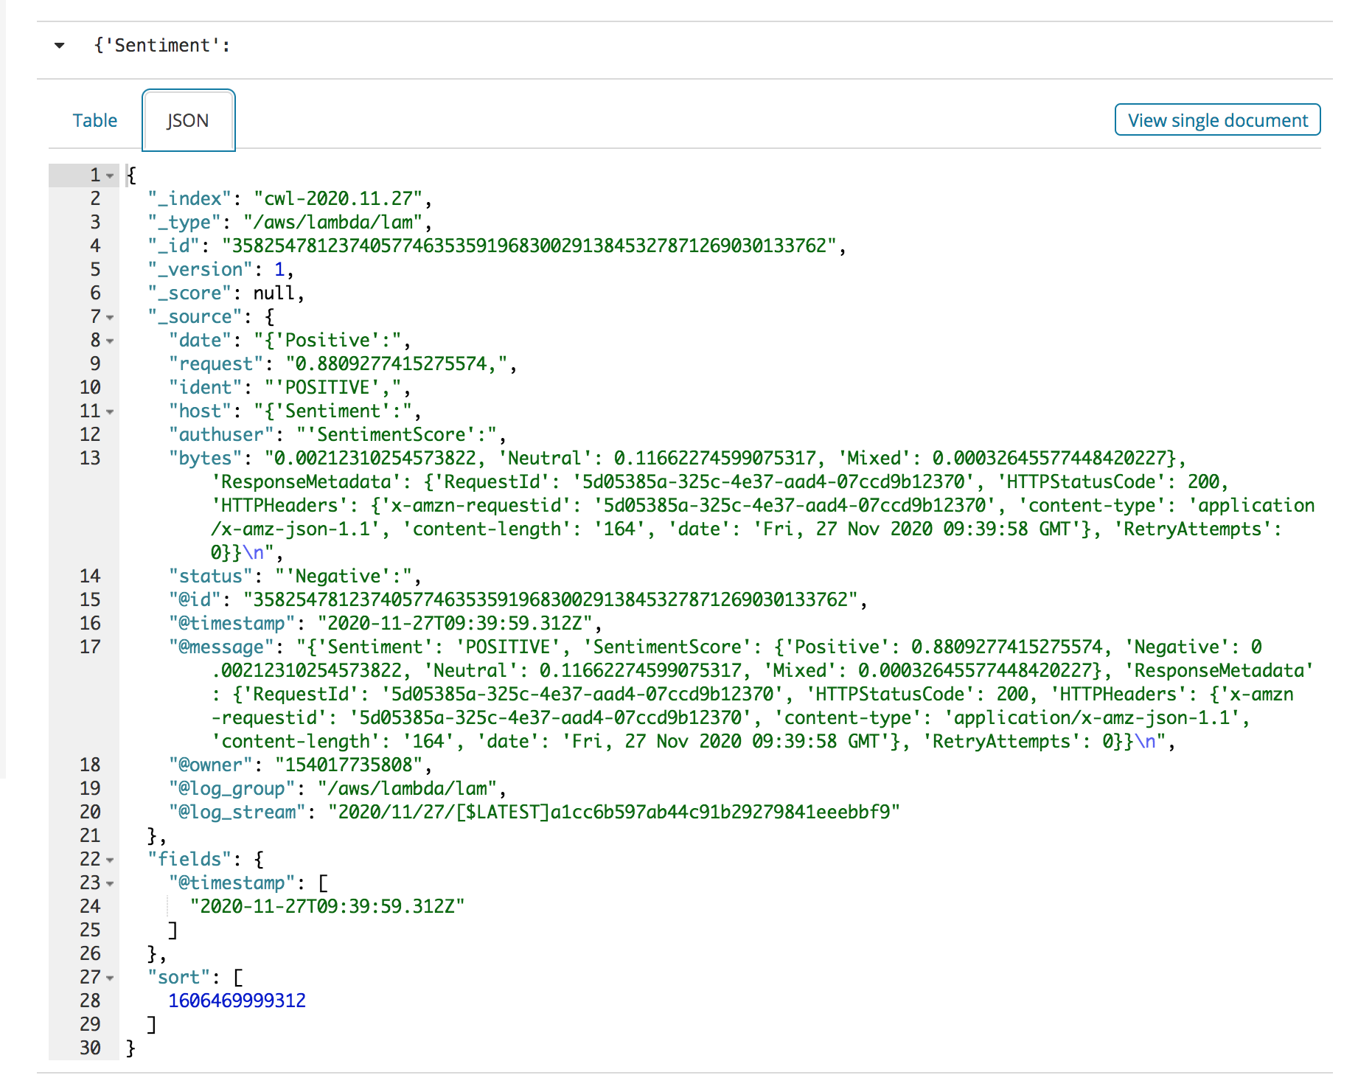
Elasticsearch data snapshot

Slide 13
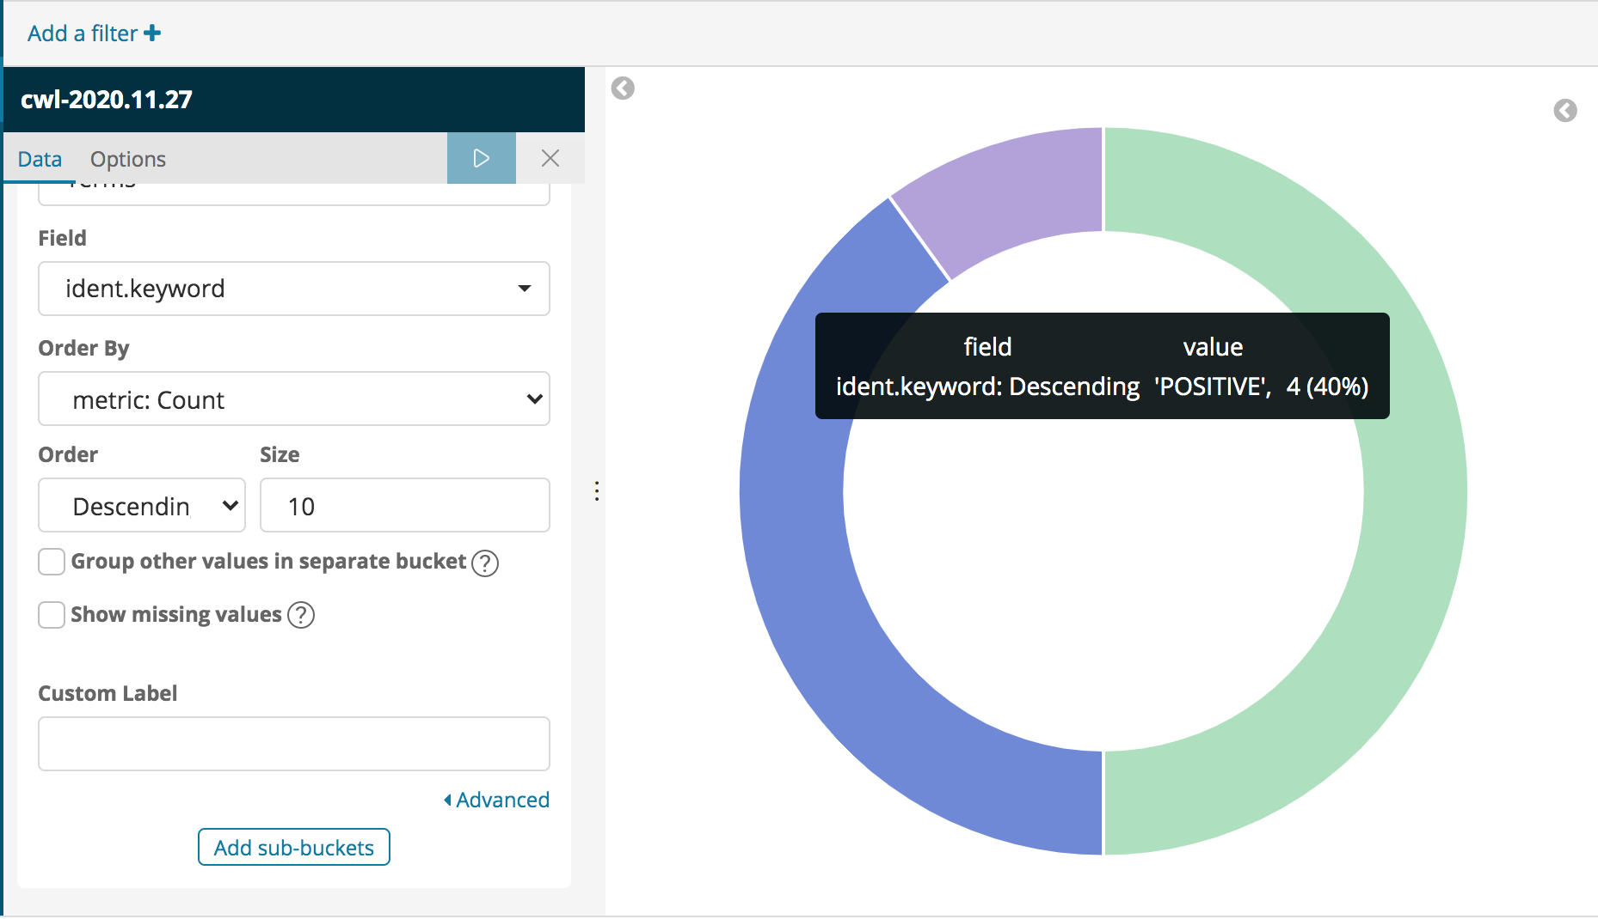
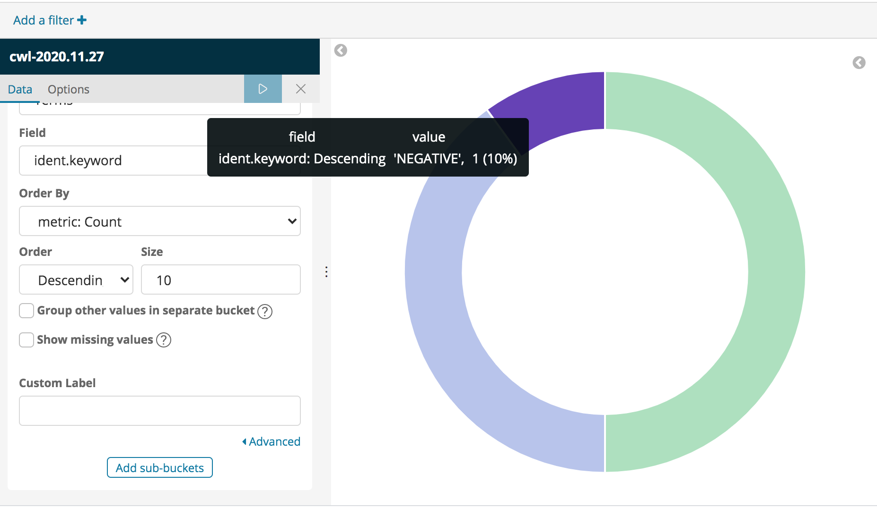
Kibana:
Kibana is an open-source data visualization and exploration tool used for analytics, application monitoring, and operational intelligence use cases.
It provides tight integration with ElasticSearch, which makes Kibana the default choice for visualizing data stored in Elasticsearch.

Slide 14
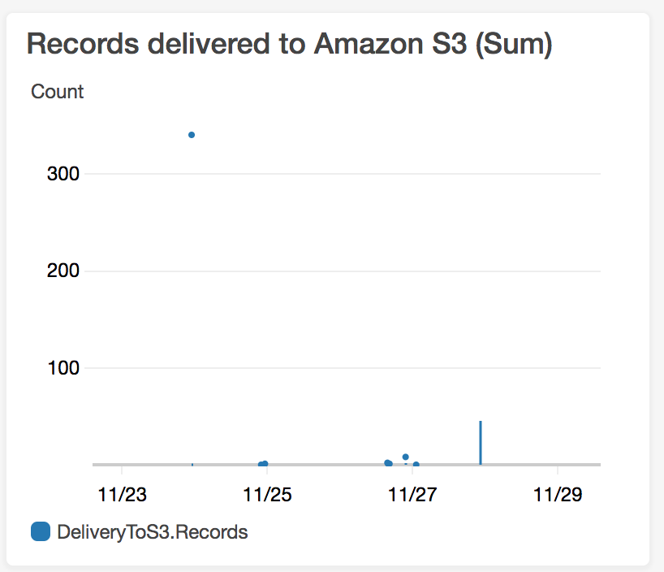
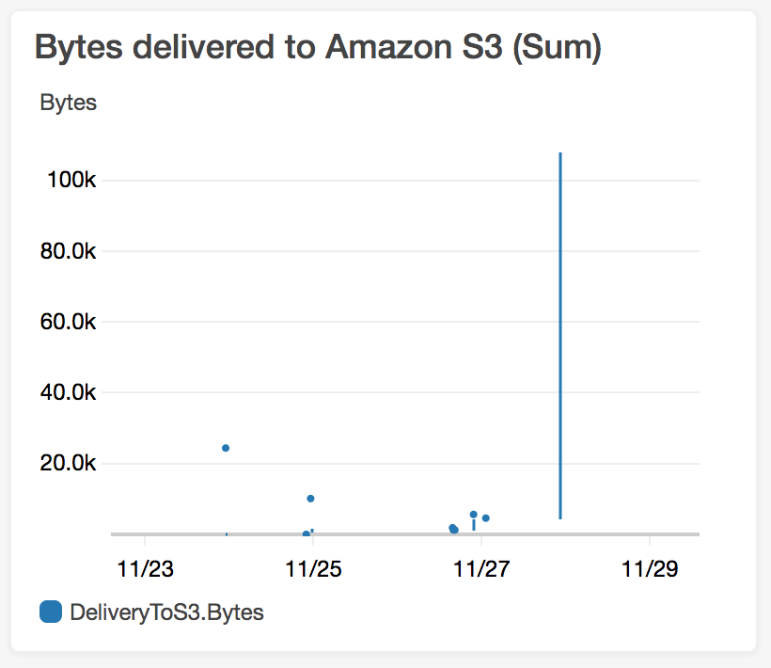
Kinesis Monitor

Slide 15
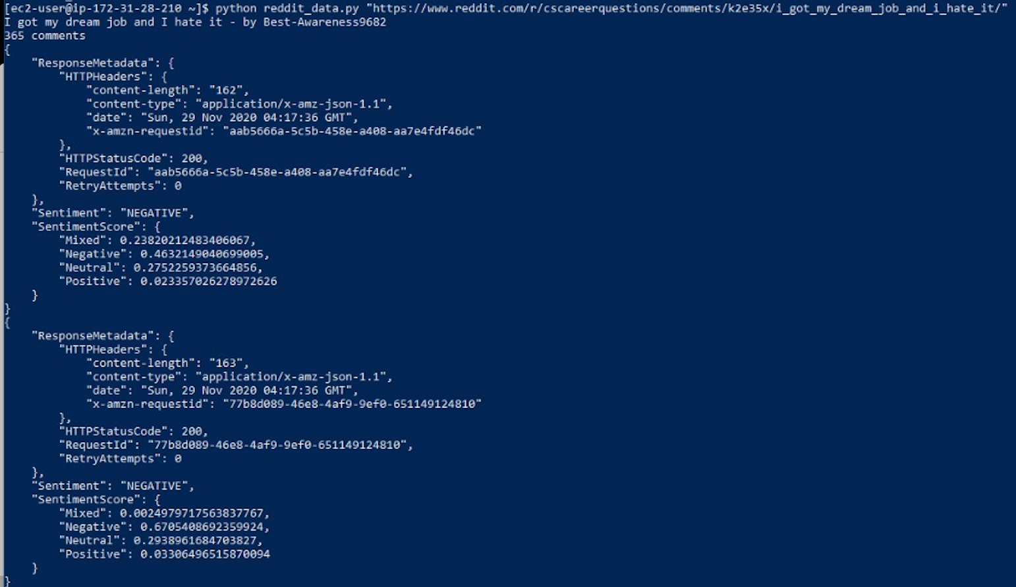
Running the python script on EC2 instance

Slide 16

Sentiment Analysis on Google Cloud platform

Slide 17
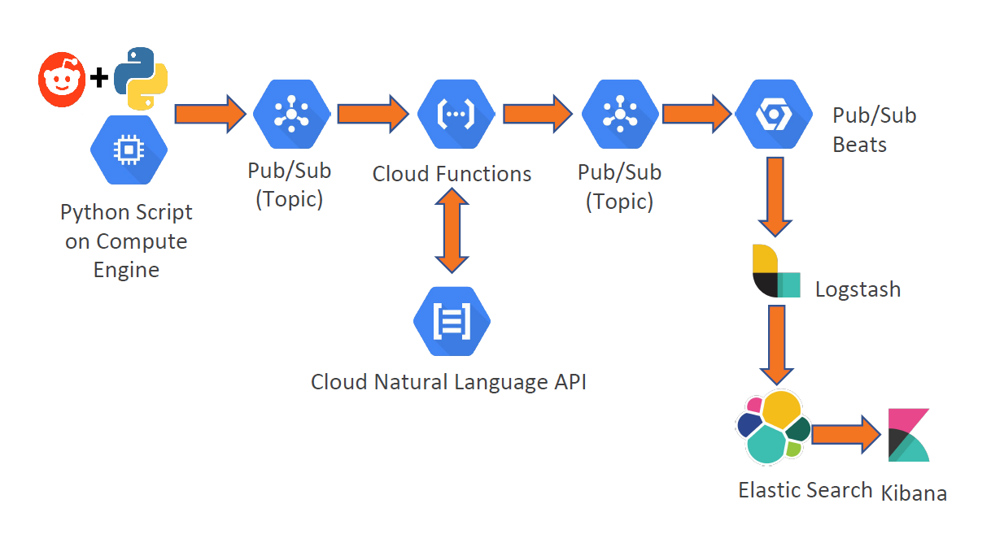
System Architecture

Slide 18
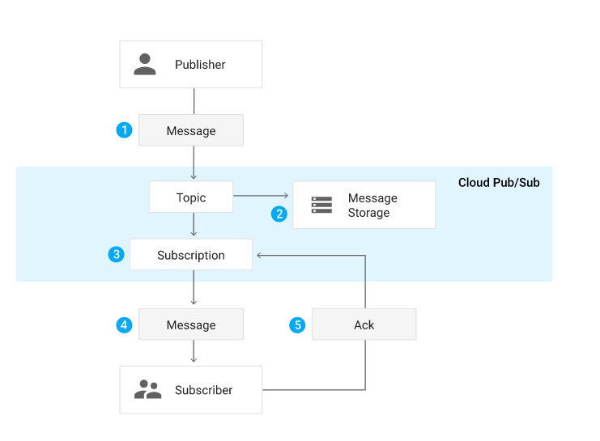
Pub/Sub
Google Pub/Sub is an asynchronous messaging service which can be used as message-oriented middleware or event ingestion and delivery for streaming analytics pipelines.
Topic: A named resource to which messages are sent by publishers.
Subscription: A named resource representing the stream of messages from a single topic, to be delivered to the subscribing application
Message: The combination of data that a publisher sends to a topic and eventually delivered to the subscribers.
Message attribute: A key-value pair that a publisher can define for a message. E.g: iana.org/language_tag and en can be added to a message to mark readable by English speaking subscriber.
Pub/Sub Message Flow

Slide 19
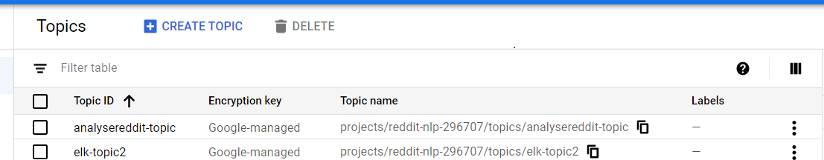
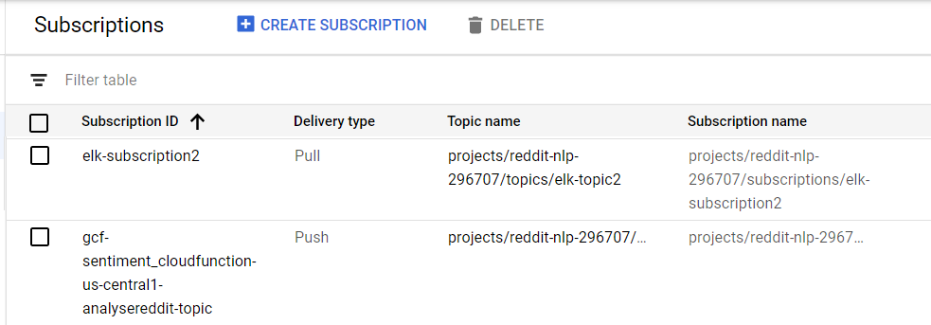
Topics and Subscriptions

Slide 20
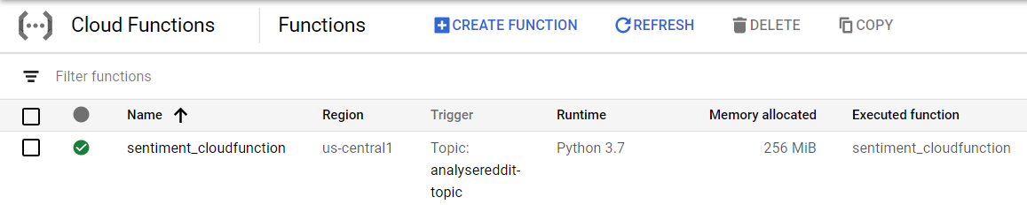
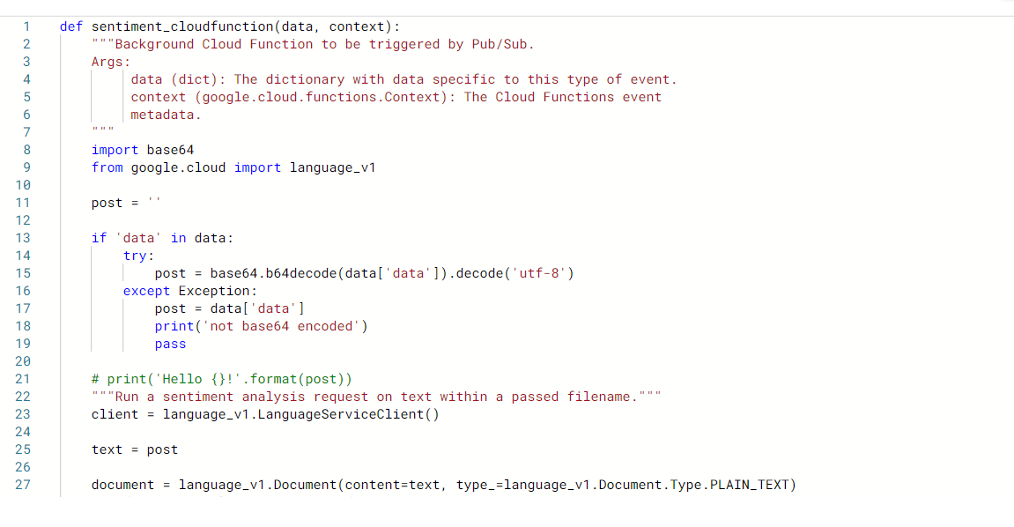
Cloud Functions
Event-driven serverless computing platform
Auto-scalable and highly available
It will be triggered by the publish event from Pub/Sub

Slide 21
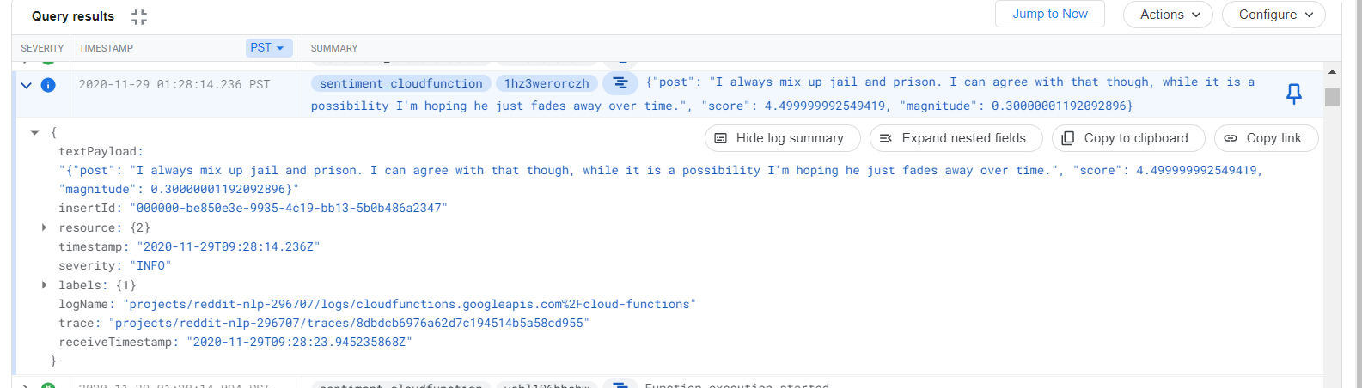
NLP Results stored in Logs

Slide 22




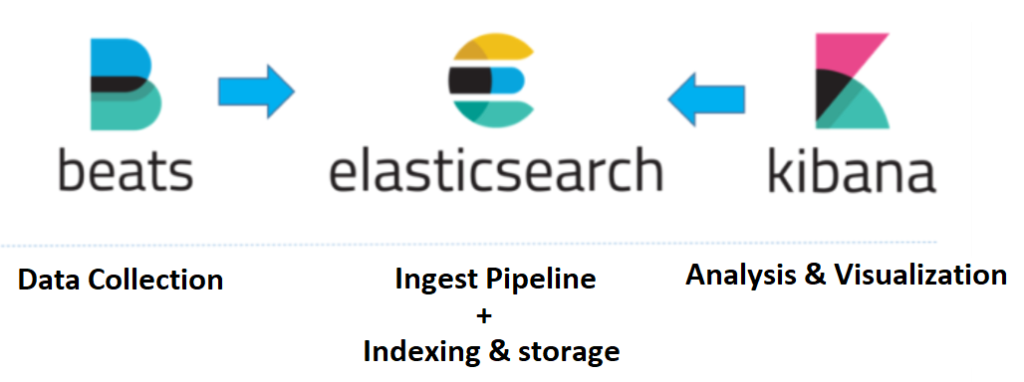
E-L-K Stack
Logstash: The server component of Logstash processes the incoming logs
Beats: Lightweight client for pulling logs for elastic storage (pubsubbeat)
Elasticsearch: Stores all the logs.
Kibana: Web interface for searching and visualizing log data

Slide 23
System Architecture revisited

Slide 24
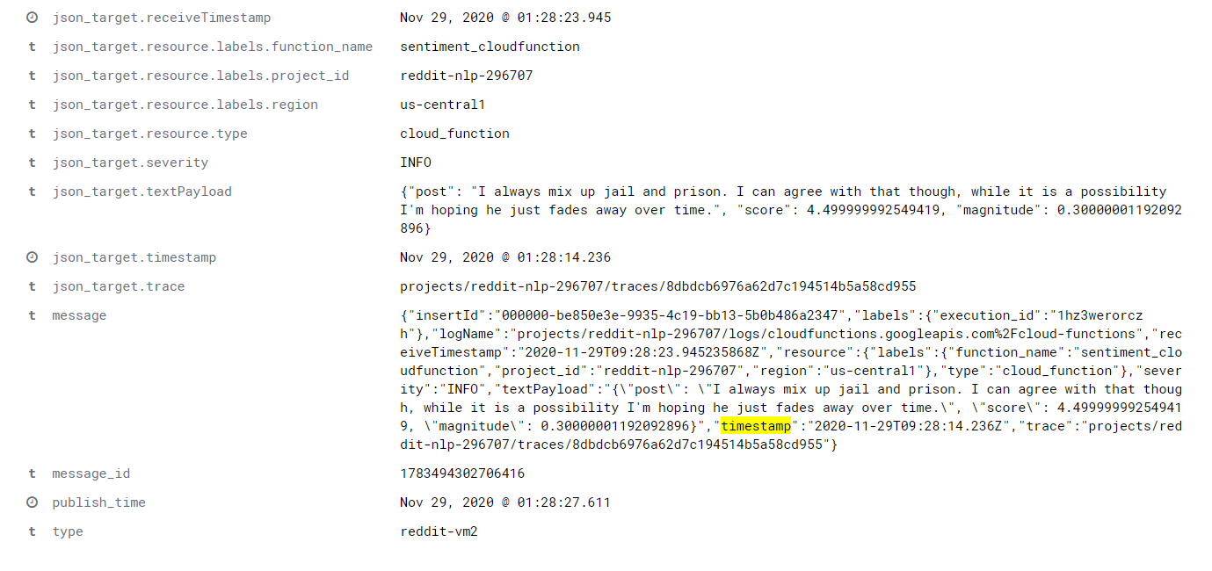
Log entries made in Elasticsearch

Slide 25
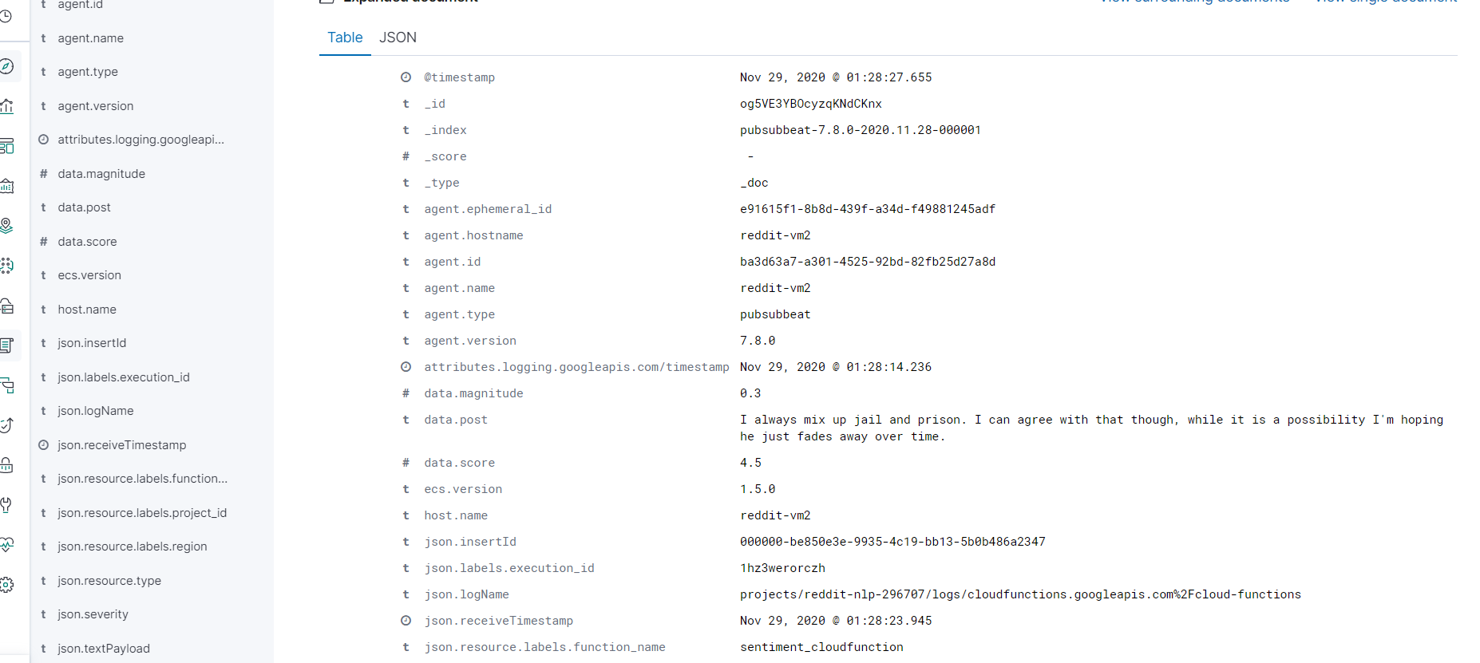
Log entries made in Elasticsearch

Slide 26
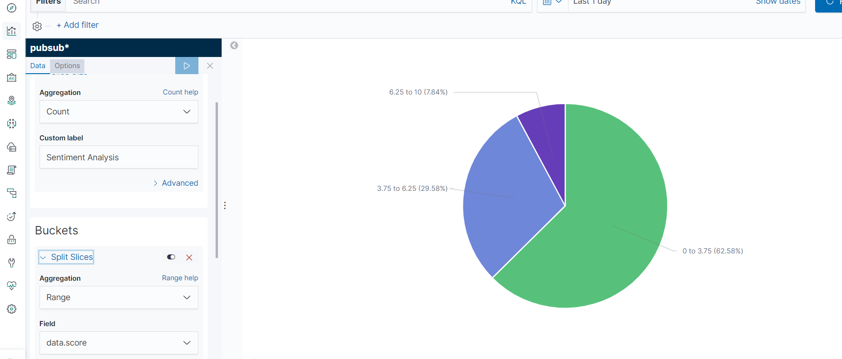
Data Visualization in Kibana
Positive : 7.84%
Negative : 62.58%
Neutral 29.58%

Slide 27
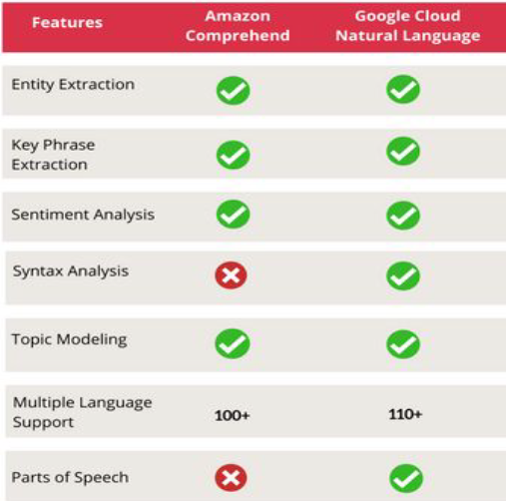
Features Comparison of NLP Services

Slide 28
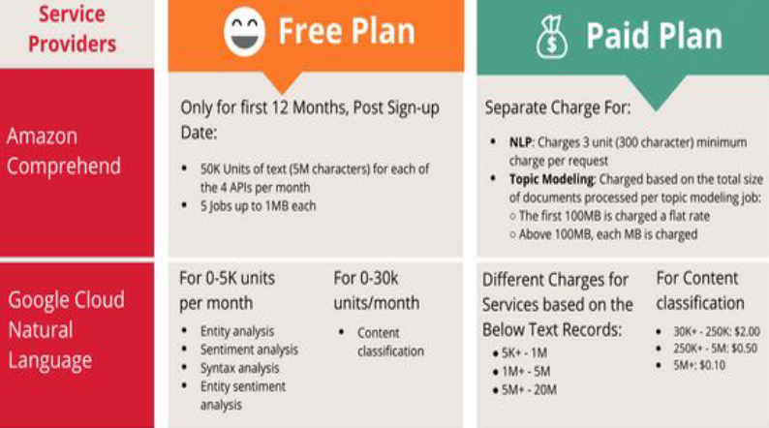
Cost Analysis

Slide 29
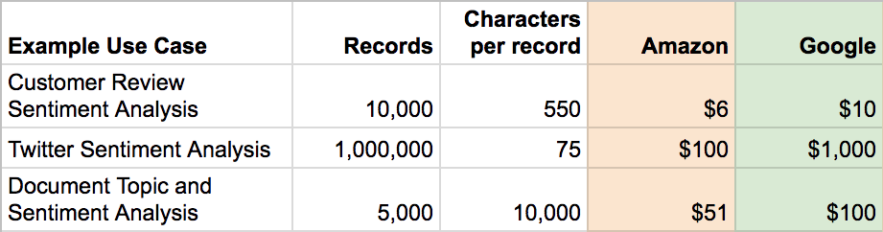
Cost Analysis Example

Slide 30
Cost Comparison Insights
Amazon is generally cheaper.
For more requests and small dataset - Amazon
For less requests and larger dataset- Google

Slide 31
Performance Check
Performed sentiment analysis on 4 subreddits
Subreddits with varying number of comments
Calculation and comparison of the execution times.
Comparison between AWS, GCP and running locally using NLTK

Slide 32
Subreddit 1
Link : https://www.reddit.com/r/cscareerquestions/comments/k2e35x/i_got_my_dream_job_and_i_hate_it/
Comments ~= 365
AWS (EC2 + Comprehend) = 29.080092 seconds
GCP (Compute + Natural Language) = 46.482045 seconds
NLTK (Running Locally) = 4.21900 seconds

Slide 33
Subreddit 2
Link : https://www.reddit.com/r/news/comments/k2n4hy/us_hospitalizations_top_90000_for_the_first_time/
Comments ~= 730
AWS (EC2 + Comprehend) = 1 minute 2 seconds
GCP (Compute + Natural Language) = 1 minute 39 seconds
NLTK (Running Locally) = 16.39 seconds

Slide 34
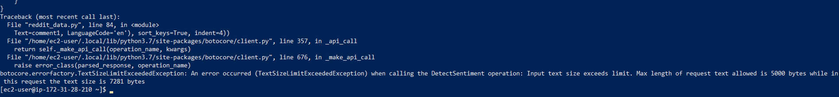
Subreddit 3
Link : https://www.reddit.com/r/cscareerquestions/comments/6ez8ag/accidentally_destroyed_production_database_on/
Comments ~= 4.2k
AWS (EC2 + Comprehend) = Input exceeded 5000 bytes
GCP (Compute + Natural Language) = 11 minutes 08 seconds
NLTK (Running Locally) = 2 minutes 36 seconds

Slide 35
Subreddit 4
Link : https://www.reddit.com/r/cscareerquestions/comments/id1tug/why_did_i_spend_4_year_getting_a_cs_degree_for/
Comments ~= 1771
AWS (EC2 + Comprehend) = 2 minutes 48 seconds
GCP (Compute + Natural Language) = 4 minutes 40 seconds
NLTK (Running Locally) = 1 minute 7 seconds

Slide 36
Performance Insights
Sentiment analysis on AWS is faster than GCP.
AWS has a limitation on the input size. Cannot exceed 5000 bytes.
GCP allows content size of 1,000,000 bytes.
Google limits the number of requests per minute to 600 and per day to 800,000. Not ideal when number of API requests/min are high as it leads to time out error. Can be resolved by adding a delay.

Slide 37
Accuracy Test
The test was carried out on Kaggle dataset which had a sentimental value assigned to it.
All the Comments in the dataset are cleaned and assigned with a Sentiment L Label Using Textblob.
Comments made by the people extracted from Various Reddit (SubReddits) Mainly Focused on Comments Made by People on Modi(2019 Indian Prime Minister candidate).

Slide 38
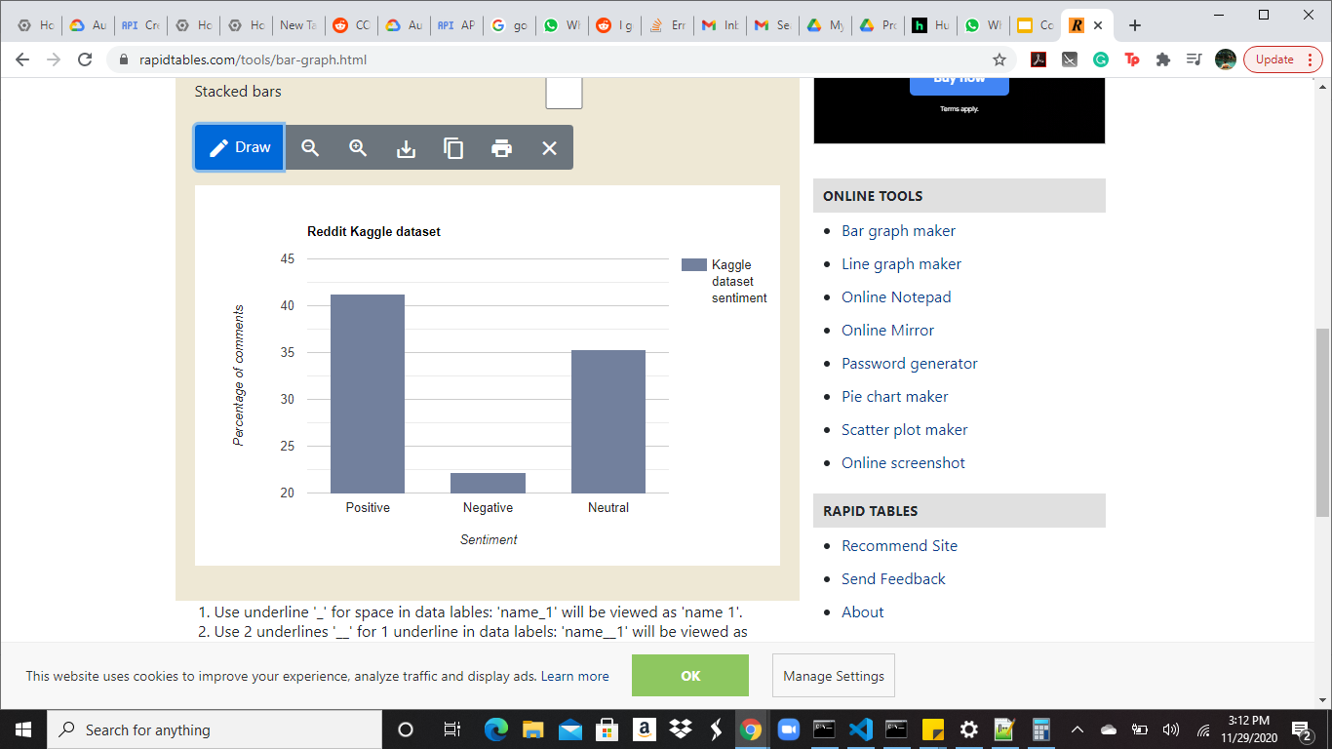
Reddit Dataset
Category | Percentage
Positive | 41.28%
Negative | 22.22%
Neutral | 35.28%

Slide 39
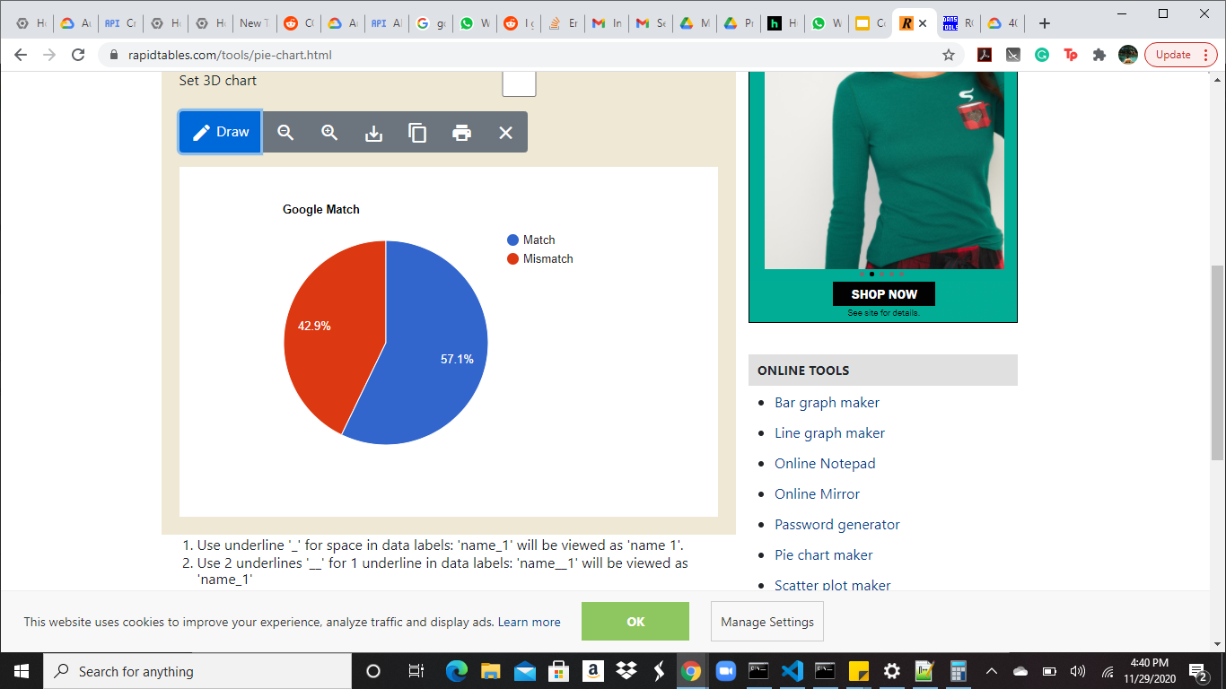
Google NLP

Slide 40
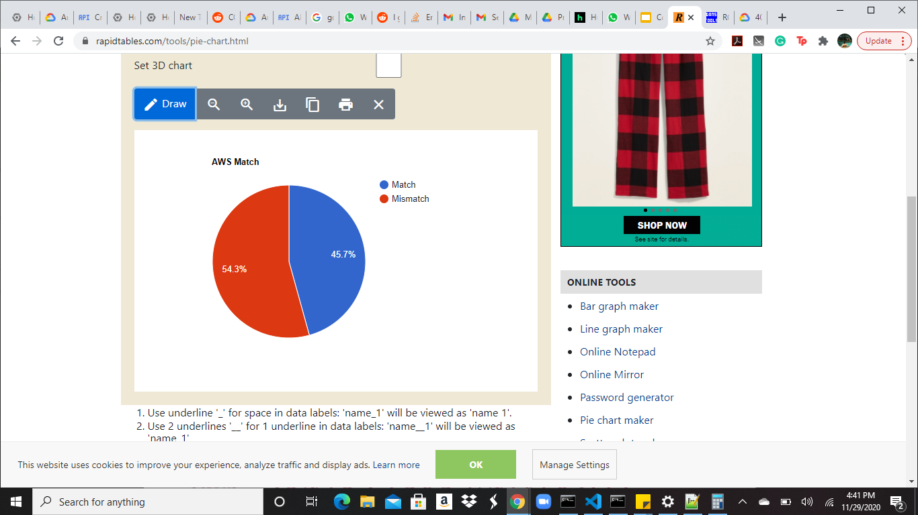
Amazon Comprehend

Slide 41
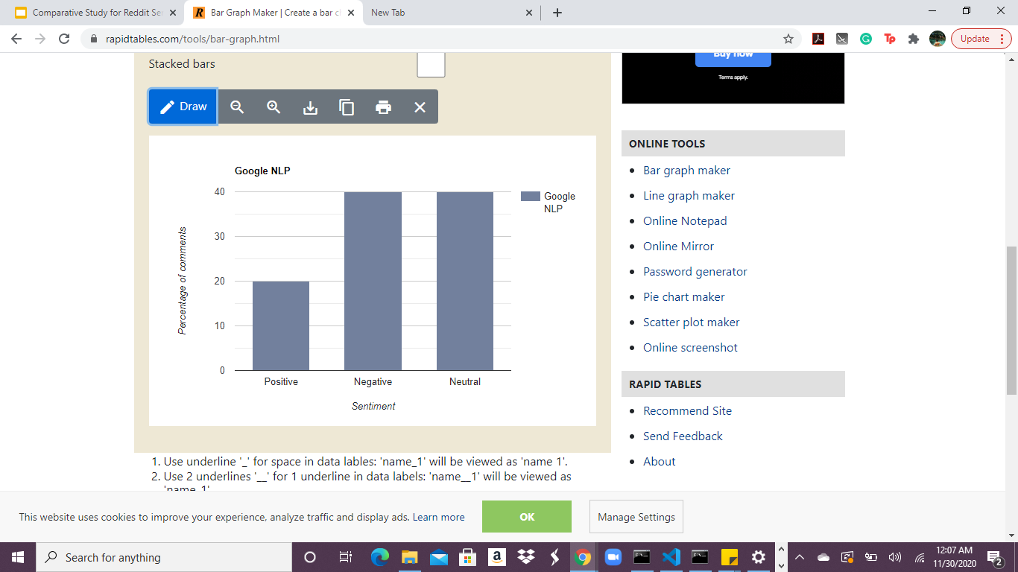
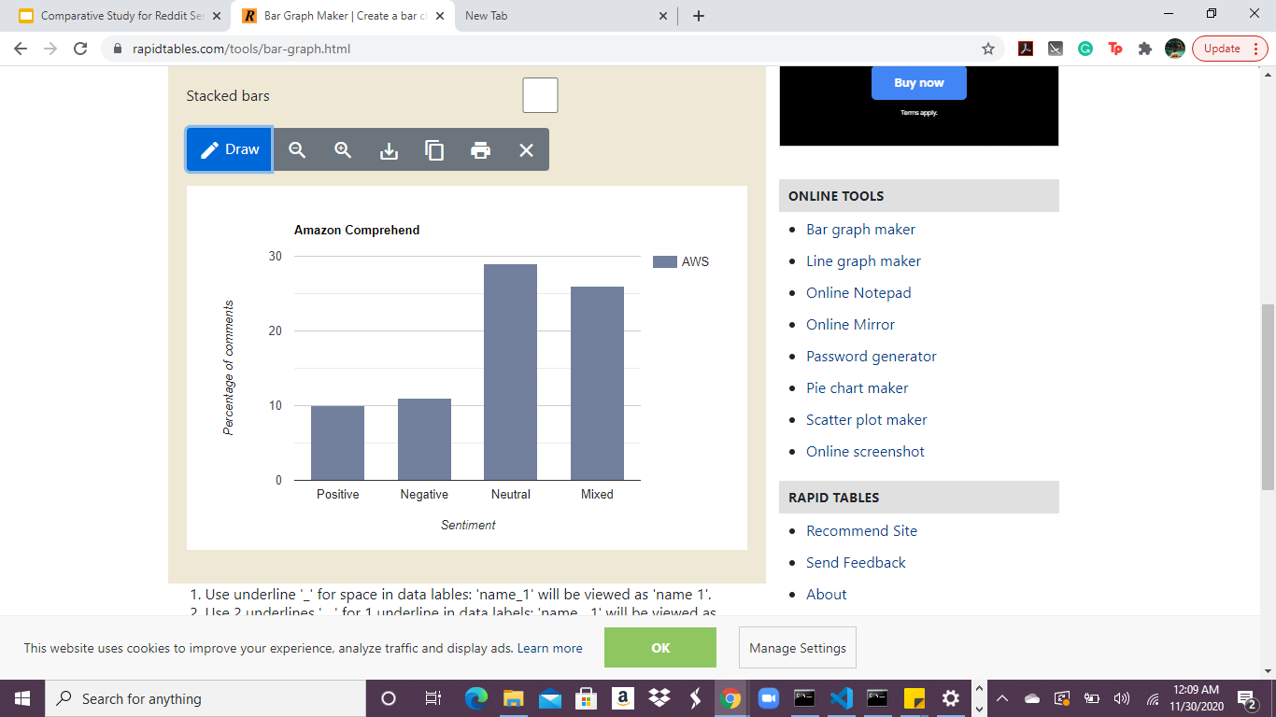
Sentiment Comparison

Slide 42
Which statements google predict wrong
Reddit comments | Sentiment | Google | Amazon Comprehend
the sabarmati waterfront really good maintained properly why autorickshaws like cram people where should only max people inside arent there any safety regulations regarding that. | Positive | Neutral | Positive
what you have learned yours and only yours what you want teach different focus the goal not the wrapping paper buddhism can passed others without word about the buddha | Neutral | Negative | Neutral

Slide 43
Which one is better?
Google NLP gave more matches compared to the Amazon comprehend.
The tests carried out on Kaggle data is unstructured.
Google NLP does a better job with unstructured data.
Google NLP also does a better job with structured data.
Reddit has some sarcastic comments too.
Which one does better in this scenario?

Slide 44
Example Comments(Sarcastic)
Reddit comments | Sentiment | Google | Amazon Comprehend
We drove so slowly---only 160 km/h | Negative | Negative | Neutral
Yeah, those kids who can't eat peanuts without dying or milk without diarrhea, or the rare kid who | Negative | Negative | Neutral
yeah, like the president is a big deal! | Negative | Negative | Positive
Oh, but didn't you know, being in a relationship means you totally have to just put up with their br... | Negative | Neutral | Negative

Slide 45
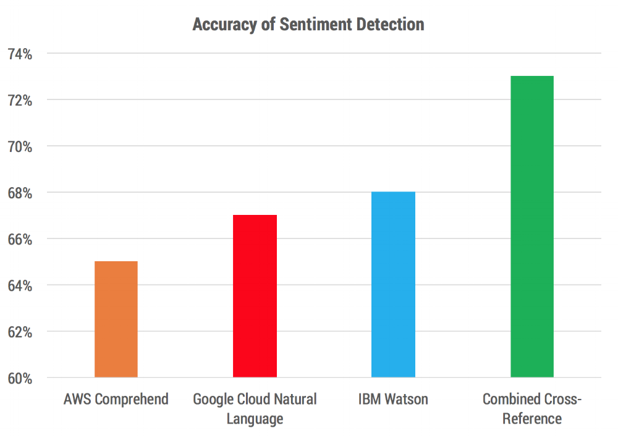

Slide 46
Conclusion
Depending on the type of text the performance of the services fluctuates.
AWS has better performance and faster execution.
AWS is less polar and provides 4 sentiment criteria compared to 3 in GNLP.
Google is highly polar and handles sarcasm detection better than AWS.
Google is more accurate with both structured and unstructured data.

Slide 47
References
https://www.deducive.com/blog/2018/6/02/using-r-for-sentiment-analysis-with-aws-comprehend-google-cloud-natural-language-ibm-watson
https://mindcraft.ai/automated-nlp/
https://logz.io/blog/google-pub-sub/
https://cloud.google.com/functions/docs/tutorials/pubsub
https://cloud.google.com/natural-language/docs/basics
https://www.deducive.com/blog/2018/6/02/using-r-for-sentiment-analysis-with-aws-comprehend-google-cloud-natural-language-ibm-watson

Slide 48
Thank you.

